Slide 1
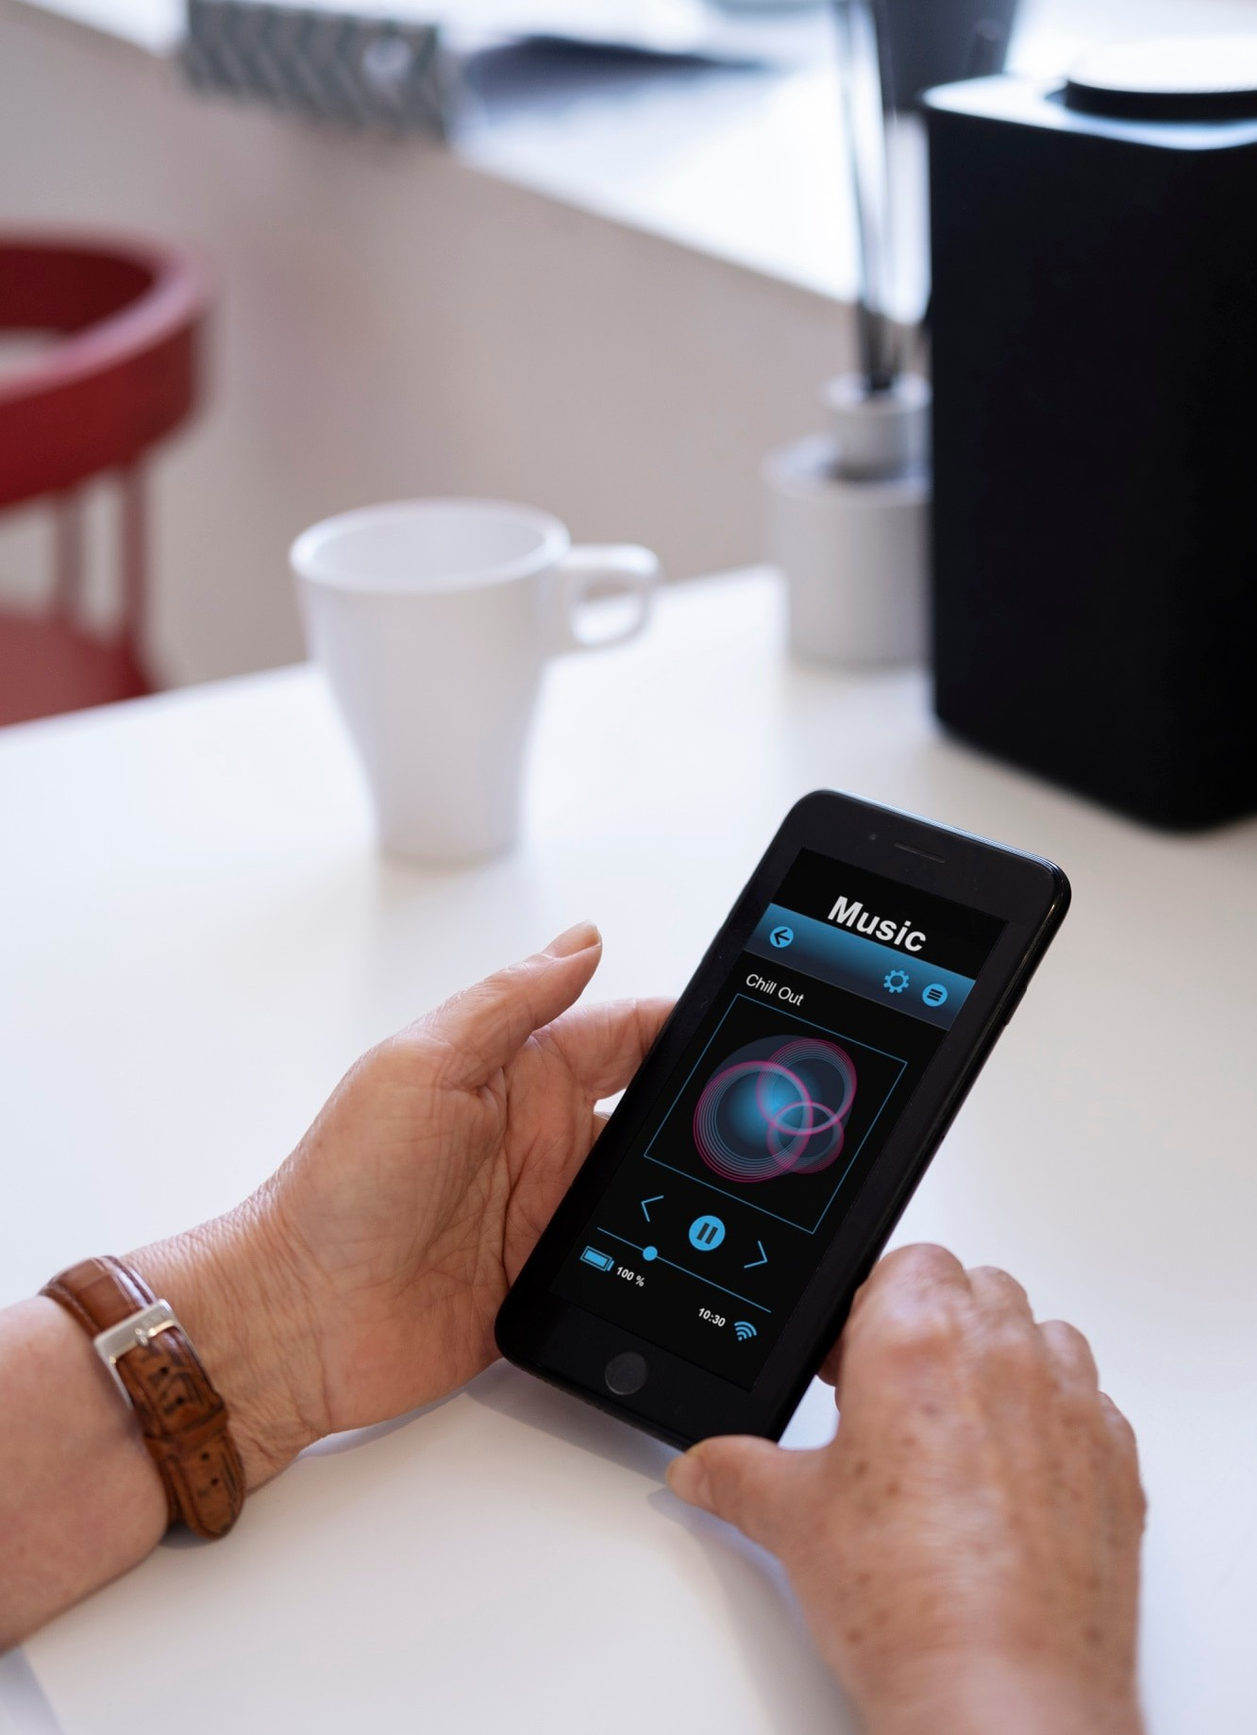


Slide 2




Slide 3


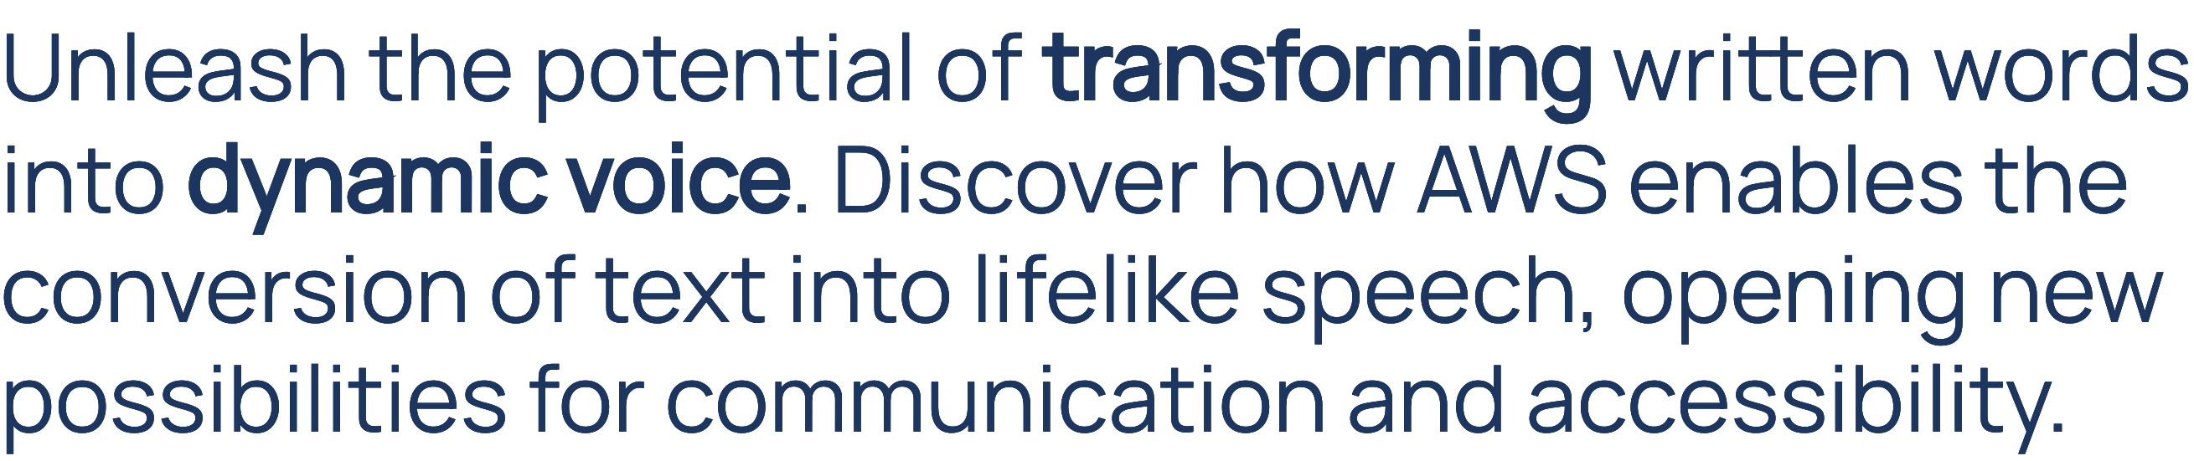

Slide 4




Slide 5
The applicatiofi’s architecture

Slide 6

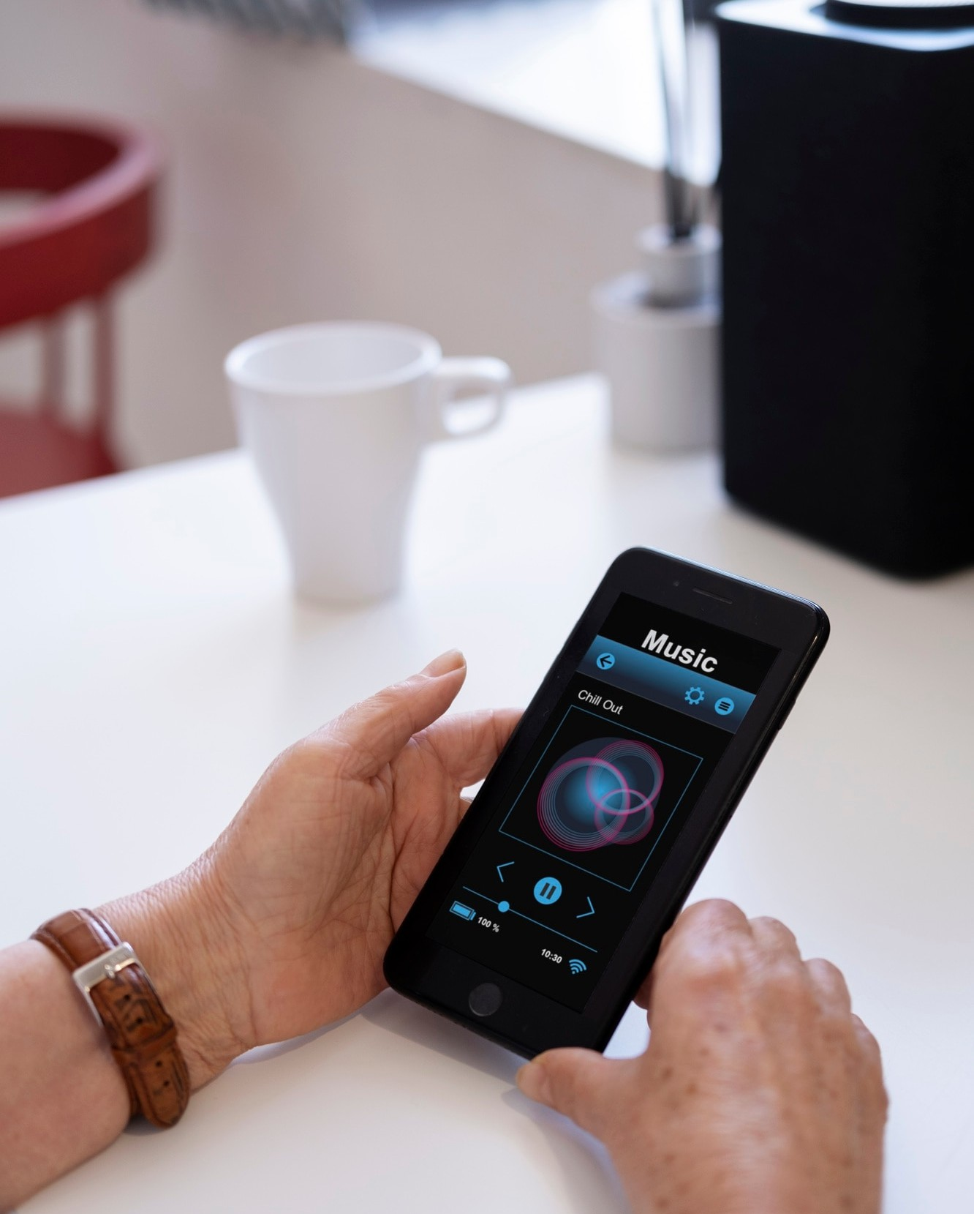


Slide 7




Slide 8




Slide 9




Slide 11



Slide 12
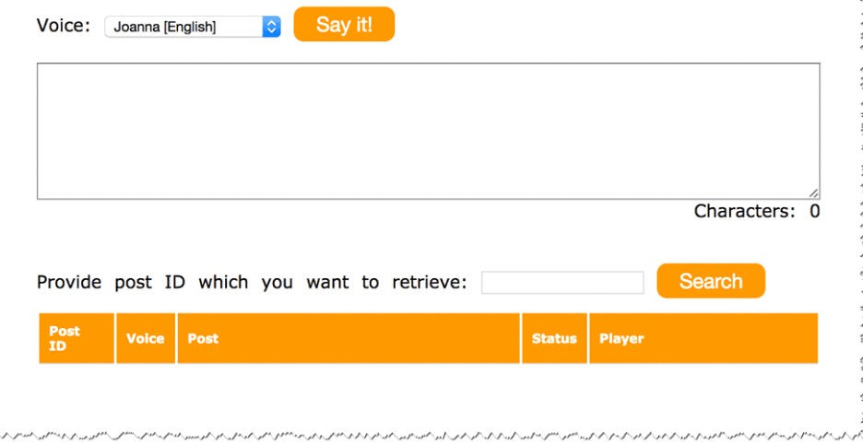
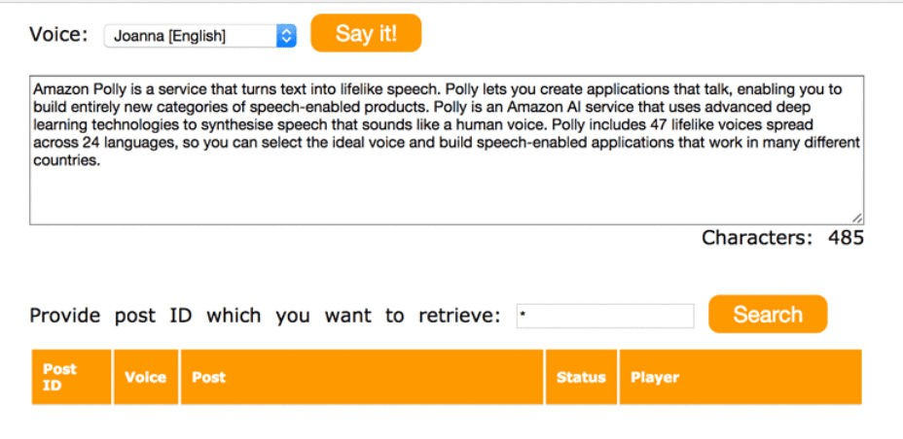

Slide 13

DO YOU HAVE ANY QUESTIONS?
youremail@freepik.com
+34 654 321 432
yourwebsite.com

